Slide 1




Ryan Lin
July 28, 2024
Jarvis 2026
+123-456-7890
123 Anywhere St., Any City, ST 12345
www.2slides.com

Slide 2

Our Vision
To become a small yet mighty R&D company in Vietnam, aligned with world-leading technical capabilities, pioneering advanced AGI applications globally.

Slide 3

Core Philosophy
AI Governance
Lean Team
Establishing ethical guidelines and robust frameworks for AI development and deployment, ensuring responsible innovation.
Operating with an optimized, agile team focused on high efficiency and impact, leveraging individual strengths effectively.
AI-Native Talent
Full AI Integrat.
Cultivating and empowering talent with deep AI expertise and an innovative mindset, driving our technological edge.
Integrating AI across all operations and product development for maximum leverage, innovation, and strategic advantage.

Slide 4
Core Values
Transparent Comm.
Collaboration
Fostering open and honest communication throughout the organization to build trust, clarity, and mutual understanding.
Working together effectively across teams to achieve shared goals and drive collective success and innovation.
Win-Win & Sharing
Family Spirit
Promoting mutual benefit and shared success, ensuring everyone gains from our achievements and growth.
Building a supportive, inclusive, and caring environment, treating colleagues like family members.

Slide 5

2026 Financial Goals
57.8B VND Revenue
Break-even by 2027 Q2
Diverse Revenue Streams
Targeting 57.8 billion VND in annual revenue, approximately $220,000 USD, driven by diverse income streams and strategic projects.
Achieve financial sustainability and break-even point by the second quarter of 2027 through prudent management and growth strategies.
Revenue will come from Siraya Service Fee, Anti-Hijacking Commission (targeting 50 customers), Product Maintenance, TOMO AI HR Project ($6,000 USD), and Sky-Net GC Project ($50,000+ USD).

Slide 6
Organization Goals
Team Growth: 8 → 15
Key Hire: Tech Lead
Phased Expansion Plan
Expand our dynamic team from the current 8 members to 15 by Q4 2026, strengthening our R&D and operational capabilities significantly.
Recruit a highly skilled Technical Lead with an entrepreneurial mindset in Q1, vital for driving innovation and project success.
Strategic team expansion throughout the year: +3 in Q1, +2 in Q2, +1 in Q3, and +1 in Q4, ensuring sustainable growth and integration.

Slide 7
Product & Tech Goals
Existing Products
TOMO AI HR Launch
Continuously enhance our Customer Portal System and Anti-Hijacking Product, ensuring market competitiveness and user satisfaction.
Prepare for TOMO AI HR project localization in Q2 and initiate robust sales activities by Q3 2026 for effective market penetration.
Dev Process Stream
Quality & Skill Dev
Implement a Standardized Development Process and a comprehensive Project Management System in Q1 for enhanced efficiency.
Initiate Vibe Coding Training (Q1-Q2) and integrate Automated Testing (Q2) to elevate code quality and team expertise.

Slide 8
Global Expansion
TOMO AI
Cross-border expansion of TOMO AI HR, focusing on localization and sales in new markets to broaden our reach.
Q1 Exch.
Facilitate a cross-border exchange event by the end of Q1 to foster global collaboration and team synergy.
Project 1
Exchange 1
Engage in Sky-Net GC Project, aiming to integrate with 100+ games for broader market presence and user base.
Organize a second cross-border exchange in Q3, strengthening international ties and knowledge sharing across our teams.
Sky-Net
Q3 Exch.
Project 2
Exchange 2
Develop an internal R&D product with international market potential, showcasing our innovative capabilities globally.
Host a year-end party in Q4, bringing together our global teams for celebration and future strategic planning.
Team R&D
Q4 Party
Project 3
Exchange 3

Slide 9
Unicorn Group
Siraya
A key entity specializing in robust Cloud, CDN, and Security services, supporting essential digital infrastructure globally.
Tomo
An emerging AI startup focused on pioneering artificial intelligence technologies and groundbreaking applications.
Cloud/CDN
AI Startup
The core software development arm, driving innovation in AGI applications and cutting-edge solutions for various sectors.
Provides comprehensive IT solutions, ensuring efficient and reliable technological operations across various industries.
Jarvis
Sky-Net
Software
IT Solut.
Dedicated to iGaming Research & Development, pushing boundaries in interactive entertainment technologies.
Specializes in game publishing, bringing engaging interactive experiences to a wider global audience effectively.
Katsumitec
Ariel
iGaming
Game Pub.

Slide 10

Company Culture
Values
Our culture is rooted in Transparent Communication, Collaboration, Win-Win & Sharing, and a strong Family spirit. We prioritize a people-first approach in all our endeavors, fostering trust and mutual respect within the team.
Spirit
Embodying the spirit of 'Dare to Challenge, Don't Fear Mistakes' and 'Teamwork, Grow Together,' we actively foster innovation, resilience, and collective growth within Jarvis, encouraging continuous learning and development.

Slide 11
About Ryan Lin
Role
Experience
Jarvis Principal and Main Investor, providing strategic direction and essential capital for innovation and growth initiatives.
Over 14 years of distinguished professional experience, holding a Master's in Computer Science with deep expertise in CI/CD practices.
Background
Group Leadership
Proven track record from key leadership roles at TutorABC and USERJOY Technology, contributing to significant technological advancements.
Currently CEO of Katsumitec and a major shareholder across Siraya, Tomo, and Sky-Net, demonstrating broad influence and vision.

Slide 12
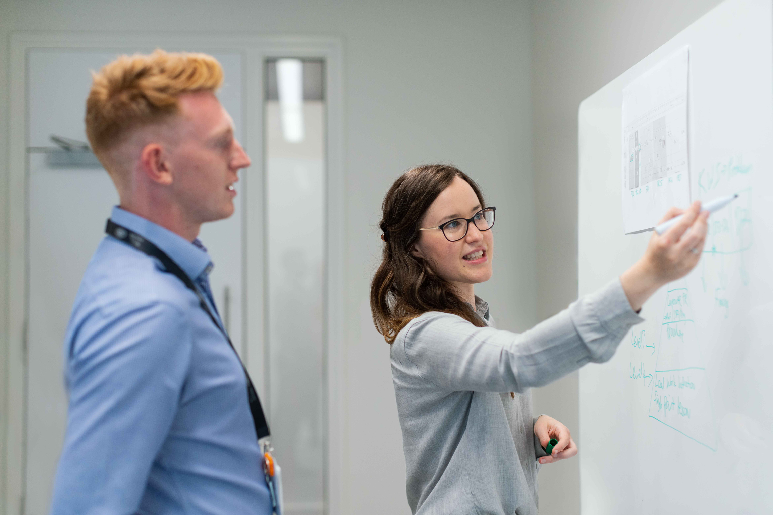
2026 Key Objectives
Revenue
Achieve 57.8B VND (~$220K USD) revenue target, securing Jarvis's financial growth and stability for the future.
Growth
Expand our dedicated team to 15 members and successfully onboard 50 new customers, enhancing our market presence.
Global
Execute 3 significant cross-border projects and host 3 international exchanges, fostering collaboration and growth for Jarvis's future.

